Slide 1

MICRO-CREDIT DEFAULTER MODEL
Submitted By:
Lakshmi Rajendra Thute

Slide 2

INTRODUCTION
A Microfinance Institution (MFI) is an organization that offers financial services to low-income populations. MFS becomes very useful when targeting especially the unbanked poor families living in remote areas with not much sources of income. The Microfinance services (MFS) provided by MFI are Group Loans, Agricultural Loans, Individual Business Loans and so on.
Many microfinance institutions (MFI), experts and donors are supporting the idea of using mobile financial services (MFS) which they feel are more convenient and efficient, and cost saving, than the traditional high-touch model used since long for the purpose of delivering microfinance services. Though, the MFI industry is primarily focusing on low-income families and are very useful in such areas, the implementation of MFS has been uneven with both significant challenges and successes.
Today, microfinance is widely accepted as a poverty-reduction tool, representing $70 billion in outstanding loans and a global outreach of 200 million clients.
We are working with one such client that is in Telecom Industry. They are a fixed wireless telecommunications network provider. They have launched various products and have developed its business and organization based on the budget operator model, offering better products at Lower Prices to all value conscious customers through a strategy of disruptive innovation that focuses on the subscriber.

Slide 3
ANALYTICAL PROBLEM FRAMING
A Microfinance Institution (MFI) is an organization that offers financial services to low-income populations. MFS becomes very useful when targeting especially the unbanked poor families living in remote areas with not much sources of income. The Microfinance services (MFS) provided by MFI are Group Loans, Agricultural Loans, Individual Business Loans and so on.
Many microfinance institutions (MFI), experts and donors are supporting the idea of using mobile financial services (MFS) which they feel are more convenient and efficient, and cost saving, than the traditional high-touch model used since long for the purpose of delivering microfinance services. Though, the MFI industry is primarily focusing on low-income families and are very useful in such areas, the implementation of MFS has been uneven with both significant challenges and successes.
Today, microfinance is widely accepted as a poverty-reduction tool, representing $70 billion in outstanding loans and a global outreach of 200 million clients.
We are working with one such client that is in Telecom Industry. They are a fixed wireless telecommunications network provider. They have launched various products and have developed its business and organization based on the budget operator model, offering better products at Lower Prices to all value conscious customers through a strategy of disruptive innovation that focuses on the subscriber.
They understand the importance of communication and how it affects a person’s life, thus, focusing on providing their services and products to low income families and poor customers that can help them in the need of hour.
They are collaborating with an MFI to provide micro-credit on mobile balances to be paid back in 5 days. The Consumer is believed to be defaulter if he deviates from the path of paying back the loaned amount within the time duration of 5 days. For the loan amount of 5 (in Indonesian Rupiah), payback amount should be 6 (in Indonesian Rupiah), while, for the loan amount of 10 (in Indonesian Rupiah), the payback amount should be 12 (in Indonesian Rupiah).

Slide 4
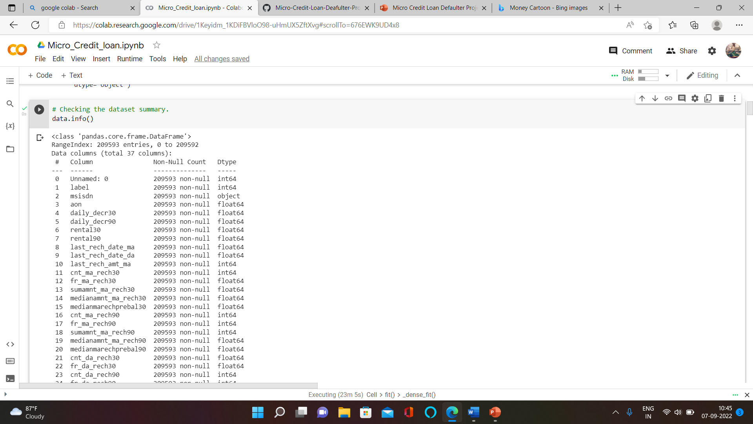
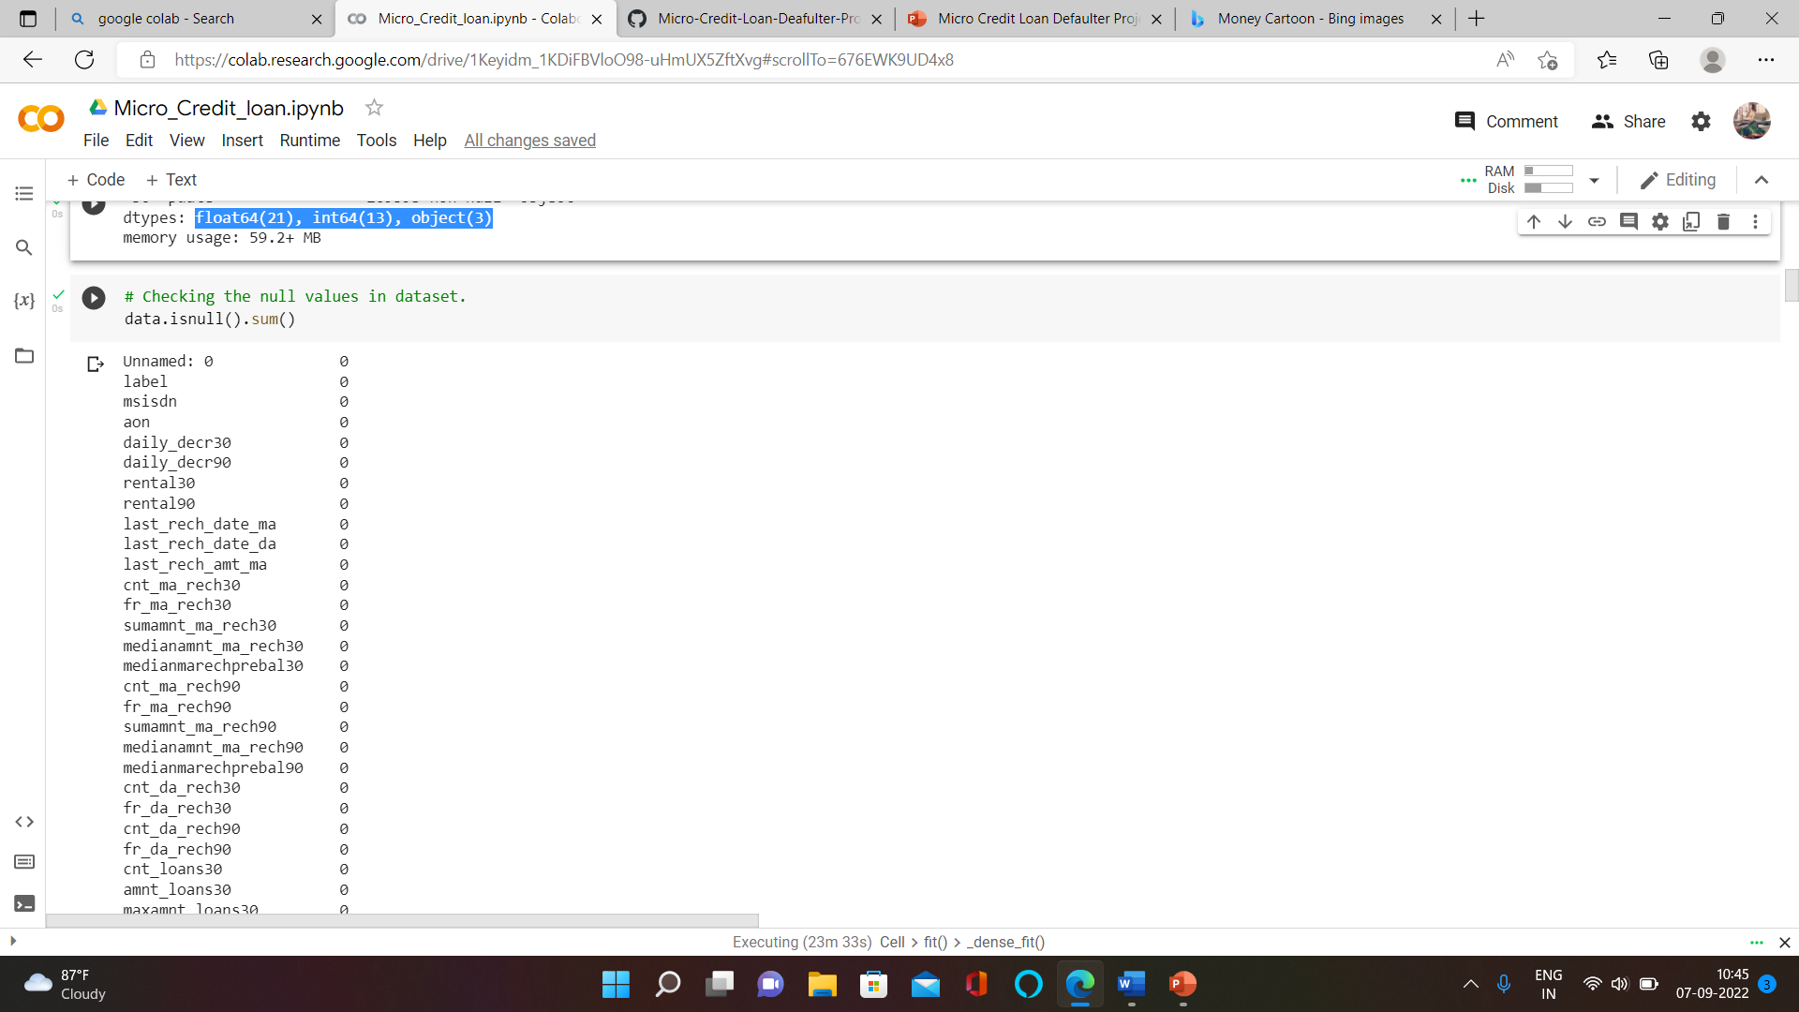
DATA COLLECTION AND PRE-PROCESSING
Data-Collection: I got the dataset in CSV format and I read the data in Jupyter Notebook using pandas data frame.
Shape of data: The dataset contains total 209593 rows and 37 columns.
Data Summary: The dataset contains float64(21), int64(13), object(3) data type columns.
Missing Values: The dataset contains missing values and we treat them with mean and mode imputation.

Slide 5
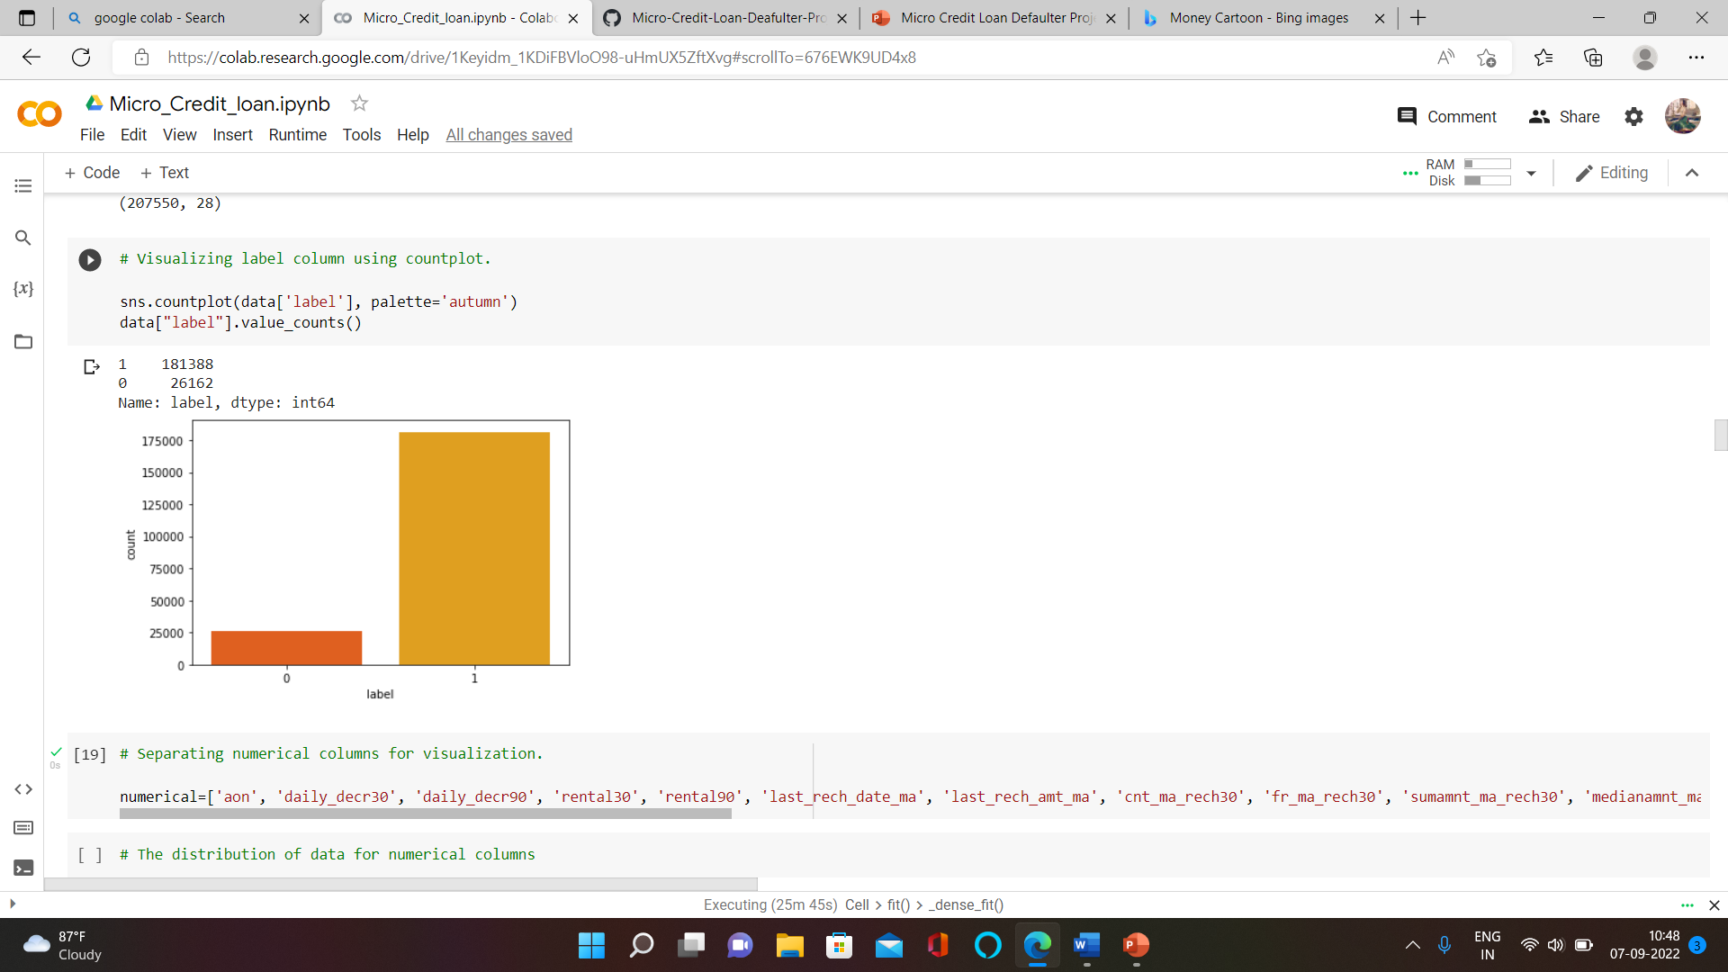
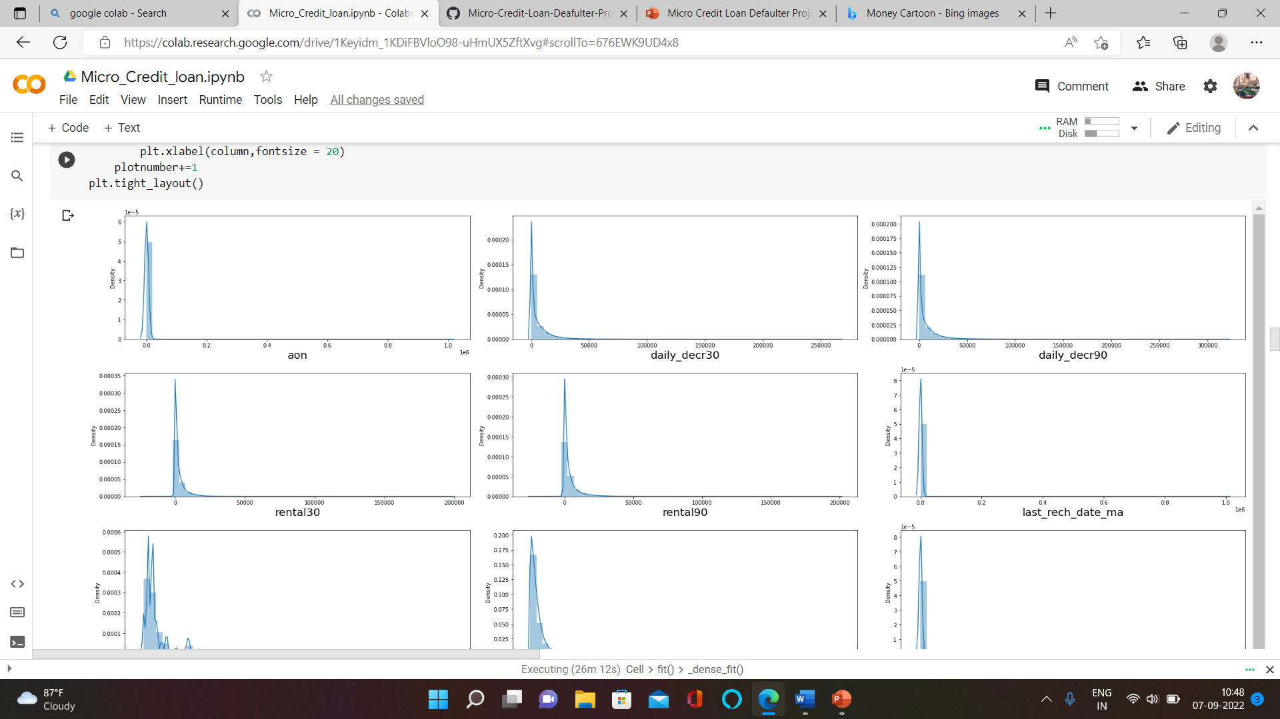
EXPLORATORY DATA ANALYSIS
Univariate Data Analysis

Slide 6
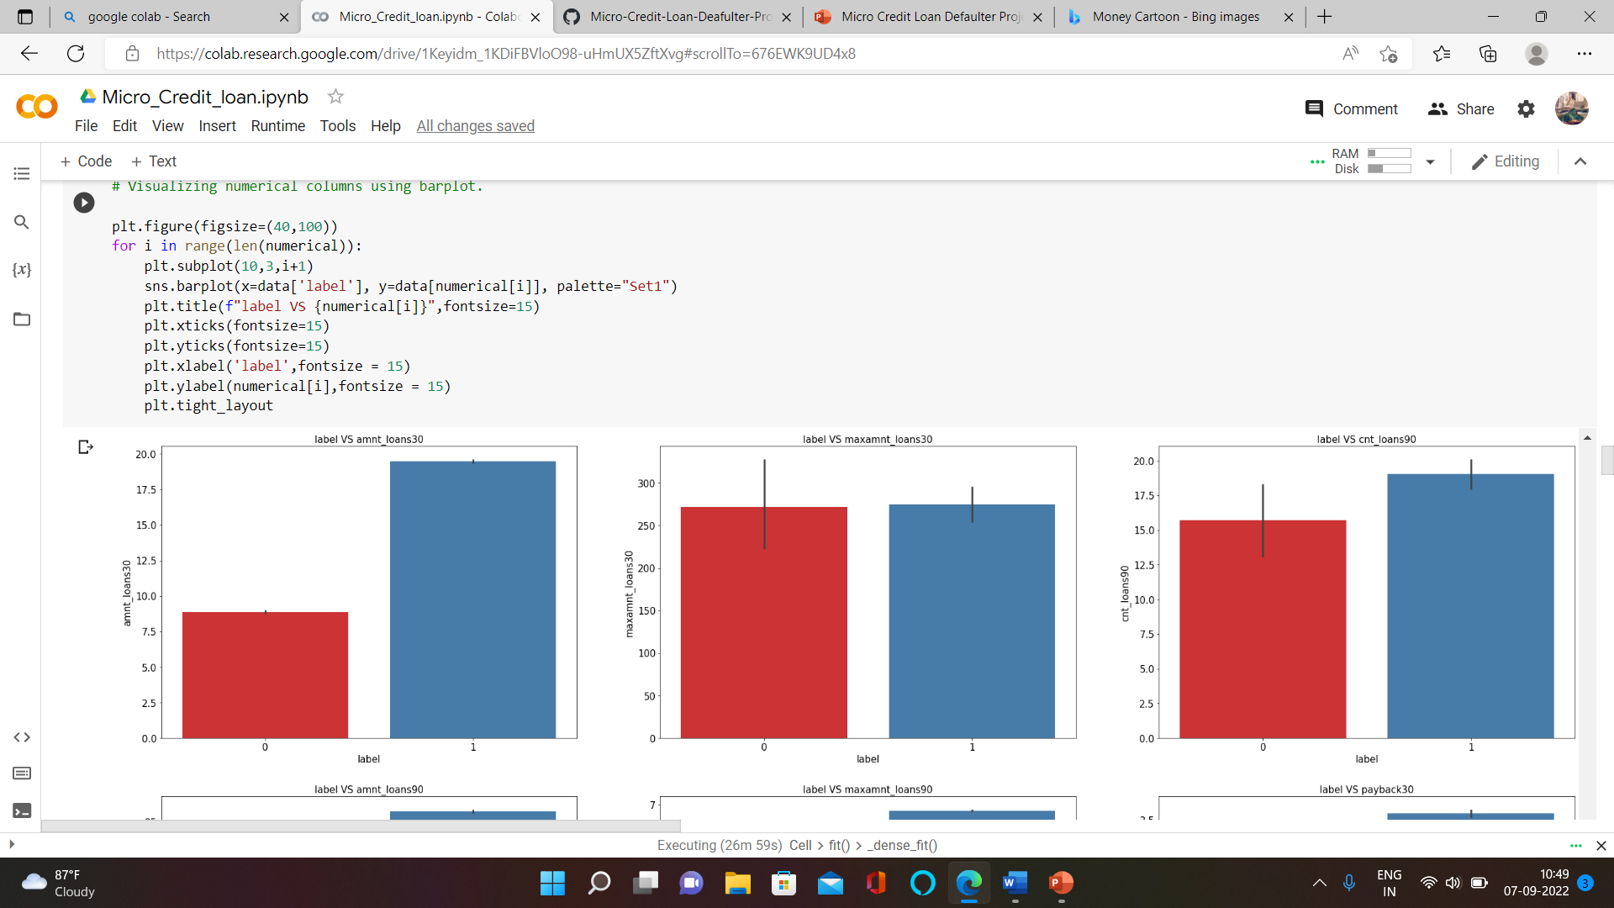
Bivariate Data Analysis

Slide 7
Observations
Customers with high value of Age on cellular network in days(aon) are maximum defaulters(who have not paid there loan amount-0).
Customers with high value of Daily amount spent from main account, averaged over last 30 days (in Indonesian Rupiah)(daily_decr30) are maximum Non-defaulters(who have paid there loan amount-1).
Customers with high value of Daily amount spent from main account, averaged over last 90 days (in Indonesian Rupiah)(daily_decr90) are maximum Non-defaulters(who have paid there loan amount-1).
Customers with high value of Average main account balance over last 30 days(rental30) are maximum Non-defaulters(who have paid there loan amount-1).
Customers with high value of Average main account balance over last 90 days(rental90) are maximum Non-defaulters(who have paid there loan amount-1).
Customers with high Number of days till last recharge of main account(last_rech_date_ma) are maximum Non-defaulters(who have paid there loan amount-1).
Customers with high value of Amount of last recharge of main account (in Indonesian Rupiah)(last_rech_amt_ma) are maximum Non-defaulters(who have paid there loan amount-1).
Customers with high value of Number of times main account got recharged in last 30 days(cnt_ma_rech30) are maximum Non-defaulters(who have paid there loan amount-1).
Customers with high value of Frequency of main account recharged in last 30 days(fr_ma_rech30) are maximum Non-defaulters(who have paid there loan amount-1) and also the count is high for defaulters comparitively Non-defaulters are more in number.
Customers with high value of Total amount of recharge in main account over last 30 days (in Indonesian Rupiah)(sumamnt_ma_rech30) are maximum Non-defaulters(who have paid there loan amount-1).

Slide 8
Customers with high value of Median of main account balance just before recharge in last 30 days at user level (in Indonesian Rupiah)(medianmarechprebal30) are maximum defaulters(who have not paid there loan amount-0).
Customers with high value of Number of times main account got recharged in last 90 days(cnt_ma_rech90) are maximum Non-defaulters(who have paid there loan amount-1).
Customers with high value of Frequency of main account recharged in last 90 days(fr_ma_rech90) are maximum Non-defaulters(who have paid there loan amount-1).
Customers with high value of Median of amount of recharges done in main account over last 30 days at user level (in Indonesian Rupiah)(medianamnt_ma_rech30) are maximum Non-defaulters(who have paid there loan amount-1).
Customers with high value of Total amount of recharge in main account over last 90 days (in Indonasian Rupiah)(sumamnt_ma_rech90) are maximum Non-defaulters(who have paid there loan amount-1).

Slide 9
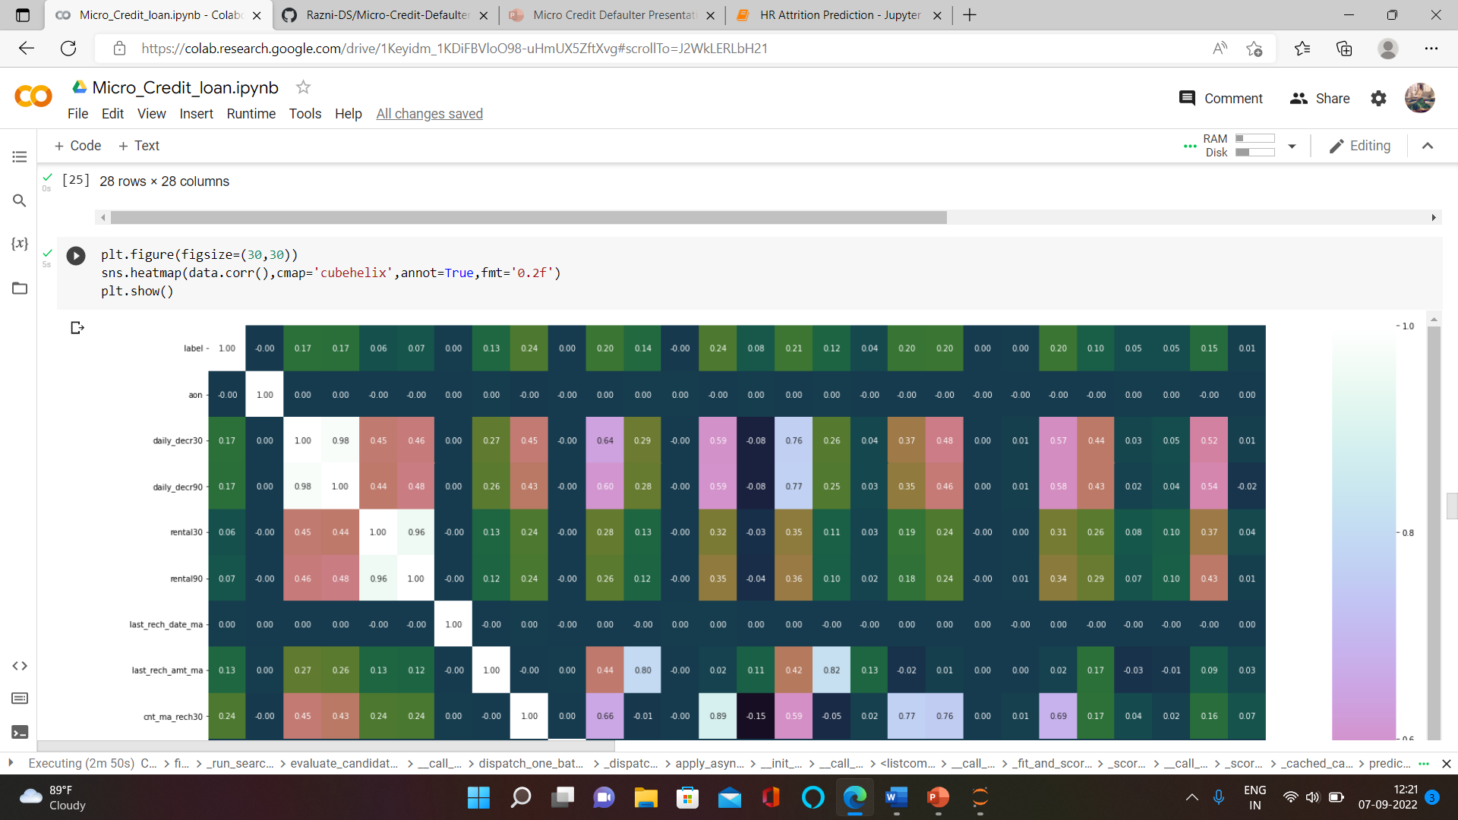
CHECKING THE CORRELATION

Slide 10
1. aon has 0% correlation with target column label.
2. daily_decr30 has 17% correlation with target column label.
3. daily_decr90 has 17% correlation with target column label.
4. rental30 has 6% correlation with target column label.
5. rental90 has 8% correlation with target column label.
6. last_rech_date_ma has 0% correlation with target column label.
7. last_rech_date_da has 0% correlation with target column label.
8. last_rech_amt_ma has 13% correlation with target column label.
9. cnt_ma_rech30 has 24% correlation with target column label.
10. fr_ma_rech30 has 0% correlation with target column label.
11. sumamnt_ma_rech30 has 20% correlation with target column label.
12. medianamnt_ma_rech30 has 14% correlation with target column label.
14. medianmarechprebal30 has 0% correlation with target column label.
15. cnt_ma_rech90 has 24% correlation with target column label.
16. fr_ma_rech90 has 8% correlation with target column label.
17. sumamnt_ma_rech90 has 21% correlation with target column label.
.

Slide 11
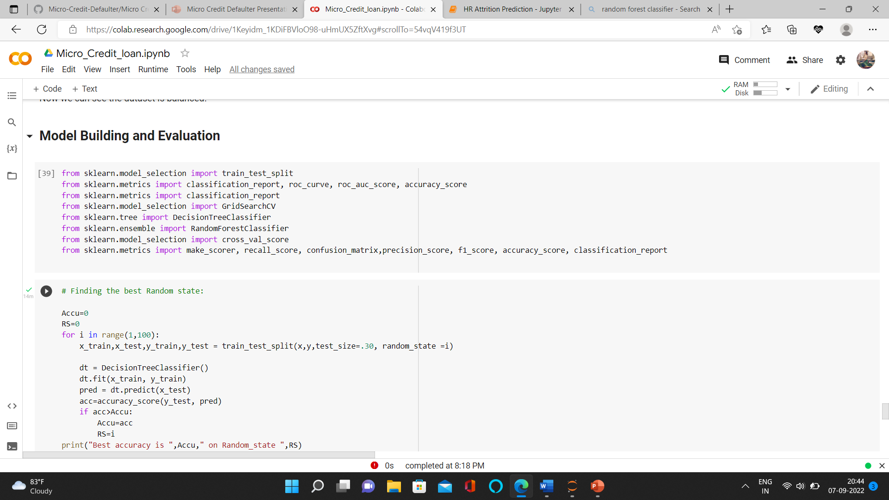
MODEL BUILDING AND EVALUATION

Slide 12
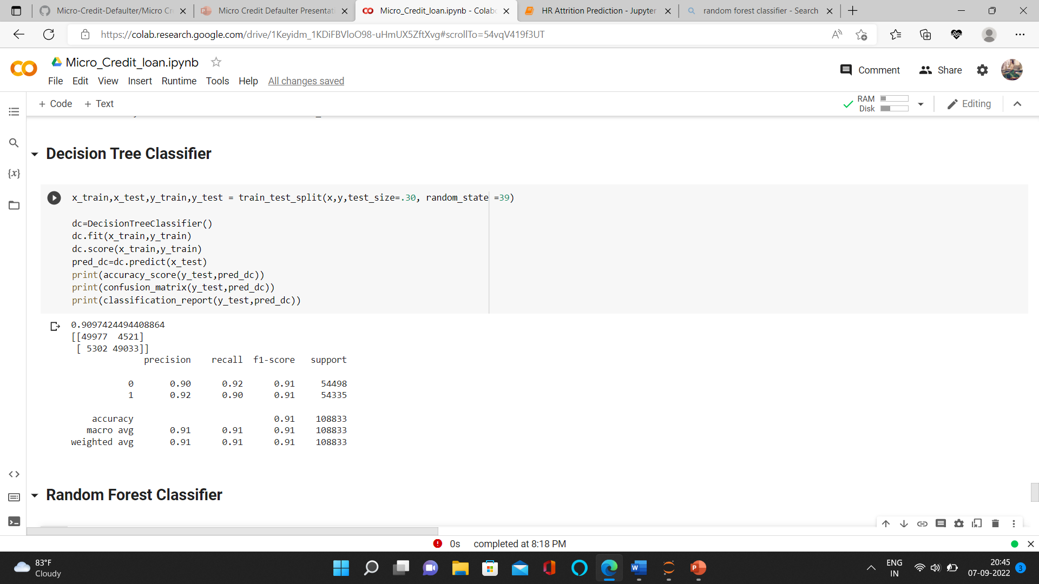
Decision Tree Classifier

Slide 13
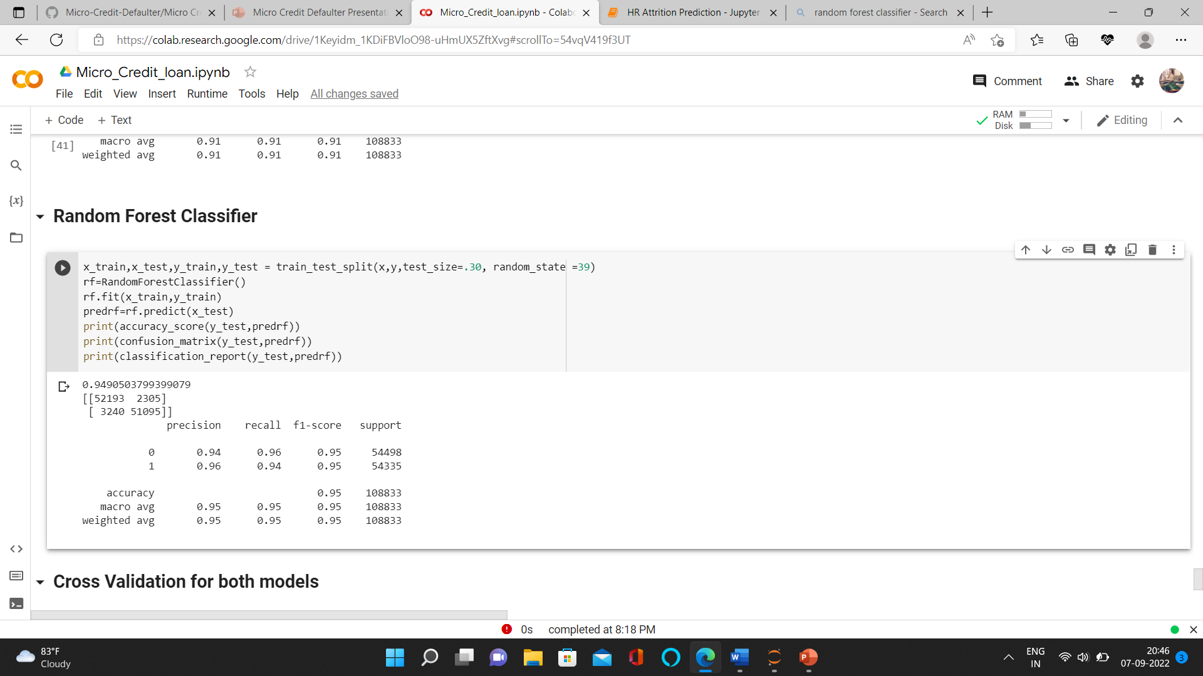
Random Forest Classifier

Slide 14
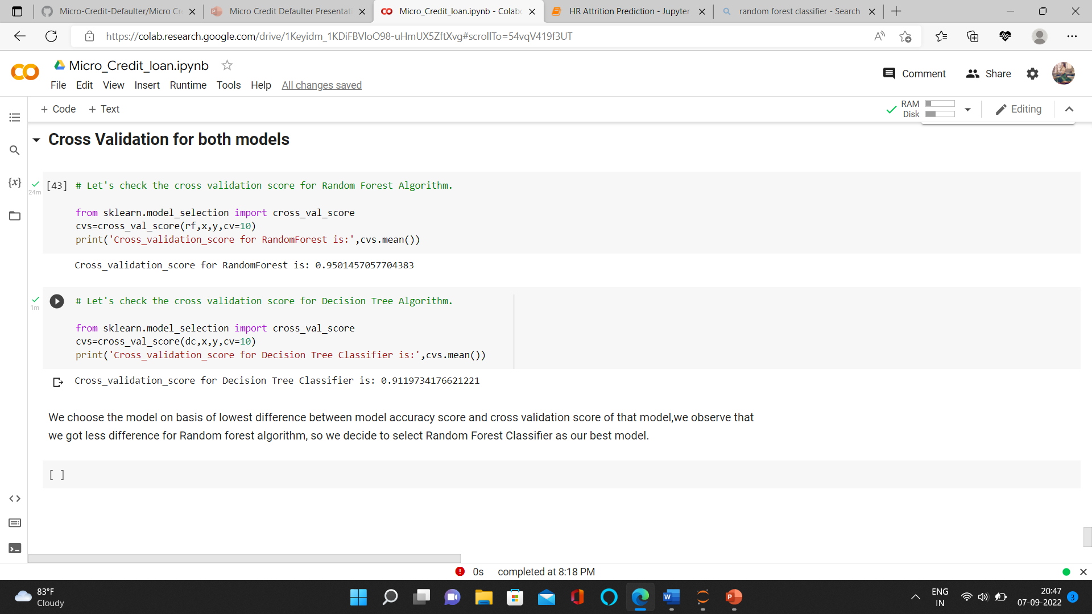
Cross Validation

Slide 15
Interpretation of Results
We choose the model on basis of lowest difference between model accuracy score and cross validation score of that model, we observe that we got less difference for Random forest algorithm, so we decide to select Random Forest Classifier as our best model.

Slide 16
Thank You

